Slide 1


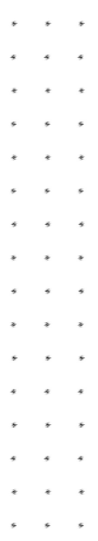
A I R R A I D A L A R M
F O R E C A S T A P I A N D
T H E C O R R E S P O N D I N G U I
S H E V C H E N K O
Y U R C H E N K O
B O H D A N
A R T U R
V A D Y M
Z A I T S E V D A N Y I L M E L N Y K
1

Slide 2
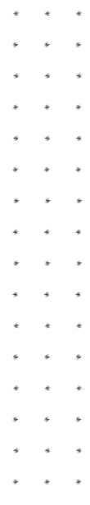
A G E N D A .
Motivation
System Design
Details about each module
Demo
Link to GitHub
2

Slide 3

O U R M O T I V A T I O N .
P R O B L E M S T A T E M E N T .
We decided to create a service that will predict air raid alarms by hour for every region in Ukraine, based on the weather data and the reports from the Institute for the Study of War (ISW). We believe this will help users plan their days accordingly and prepare them for possible danger. Also, our Air Raid Alarm Forecast API (ARAF API) can help other developers create something important. We haven‘t found any similar products in the Web, so we are proud to say, that we are now filling this gap.
3

Slide 4
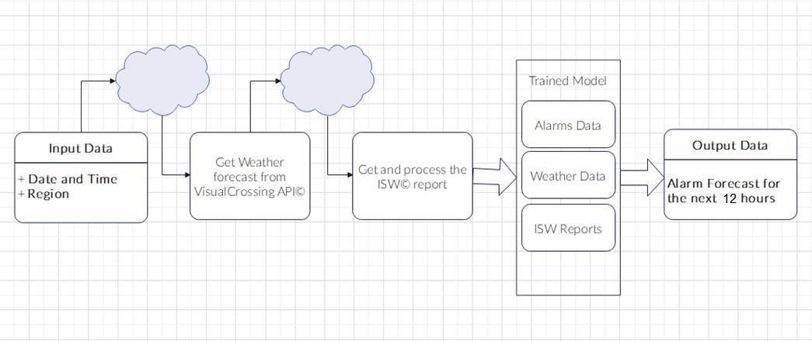

D E S I G N .
S Y S T E M
4

Slide 5
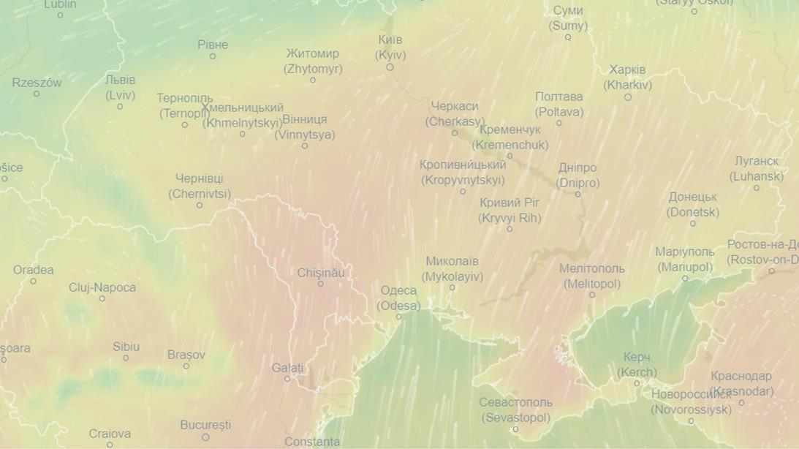
G E T T I N G W E A T H E R D A T A .
5

Slide 6
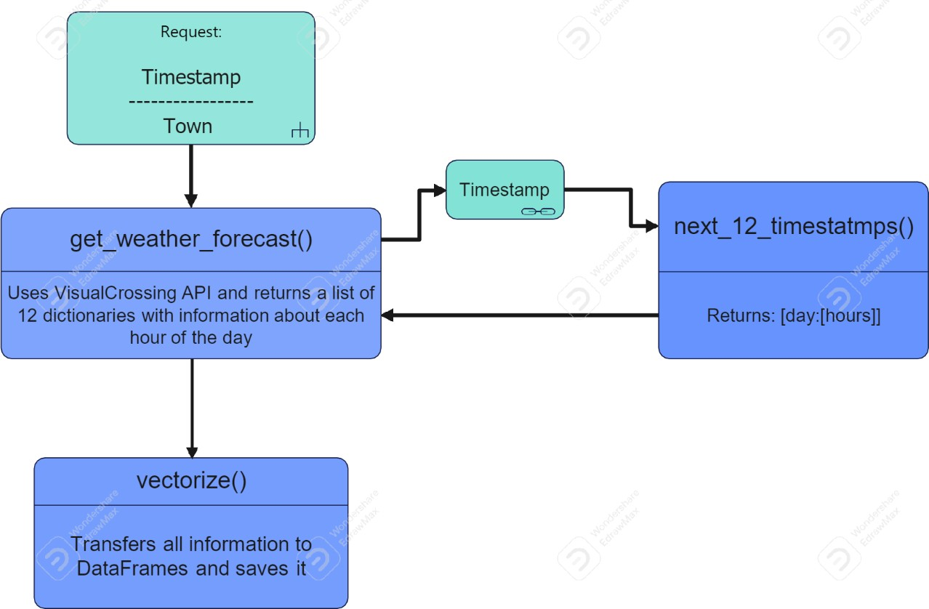
P L A N :
Sending request and getting the data in .json format
Processing the .json
6

Slide 7
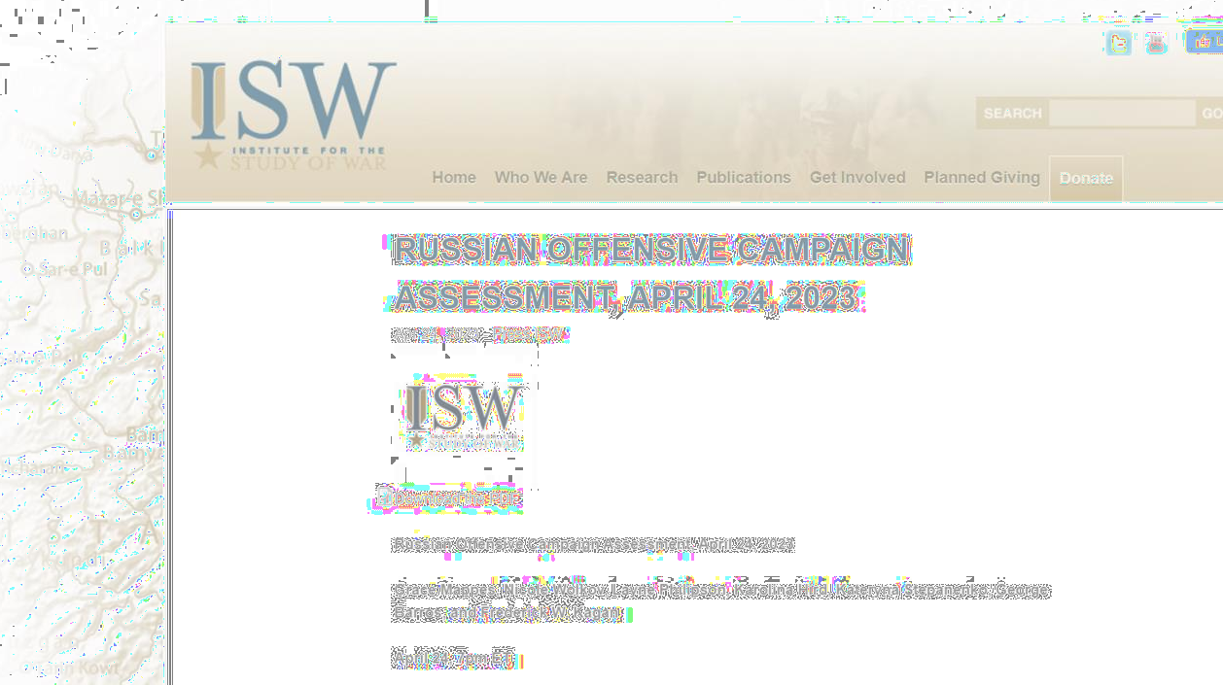
G E T T I N G T H E I S W R E P O R T .
7

Slide 8
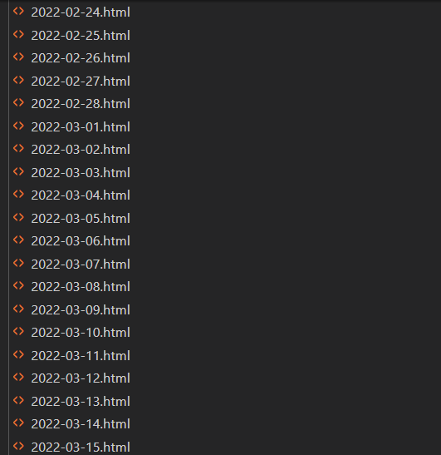
1 .
D O W N L O A D I N G T H E R E P O R T
H T M L .
8

Slide 9
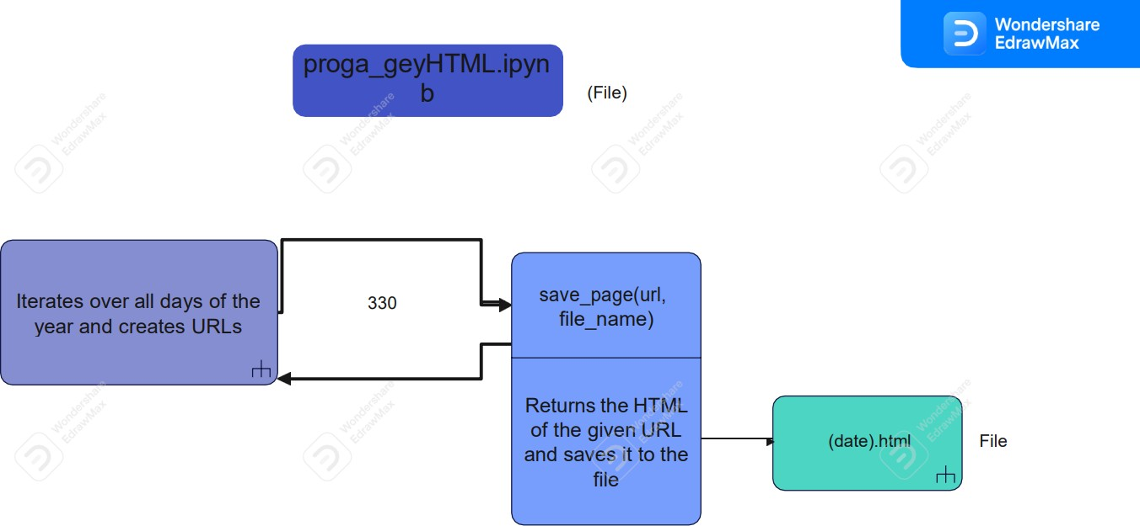

Slide 10
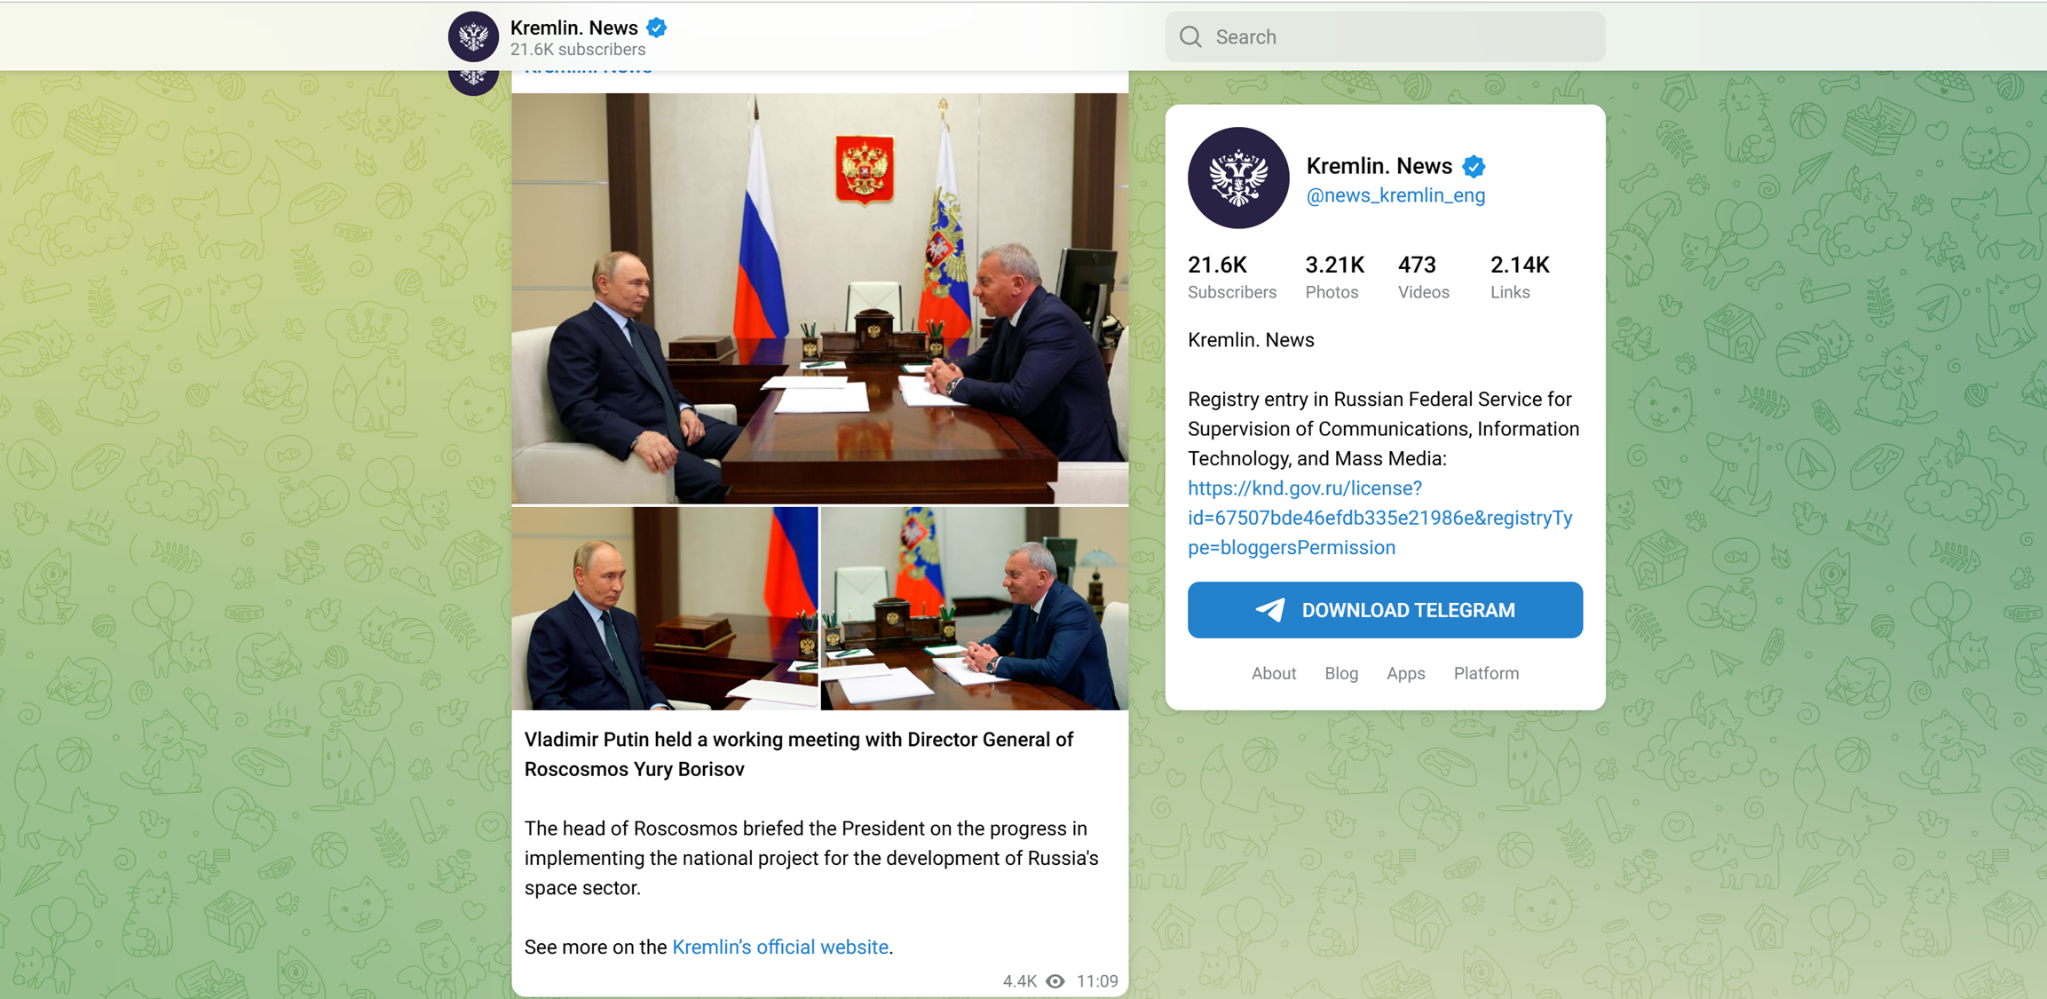
GETTING NEWS FROM TELEGRAM
We used:
Telegram MTProto API
from telethon import TelegramClient
10

Slide 11
2 . T E X T P R O C E S S I N G .
Parsing HTML.
Filtering text.
Lemmatization
Vectorization.

Slide 12
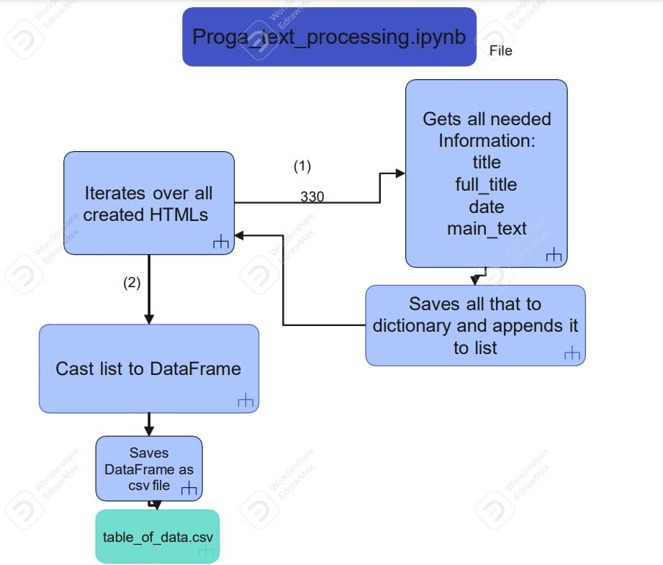
1 . P A R S I N G
H T M L .

Slide 13
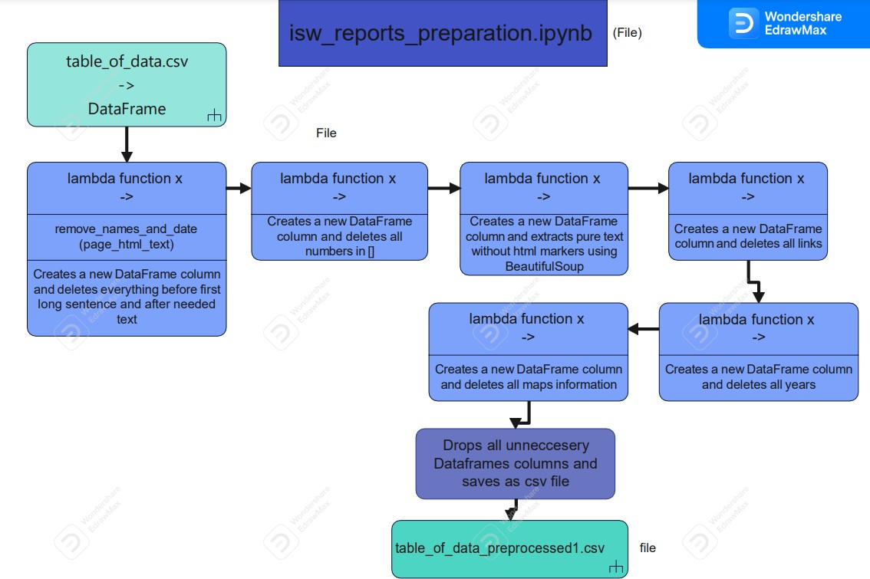
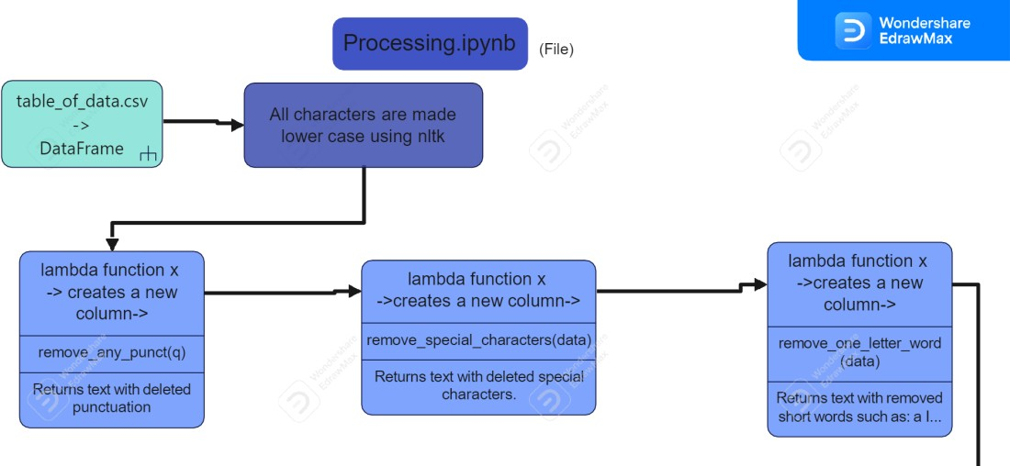
2 . F I L T E R I N G
T E X T
for HTML
5 / 6 / 2023

Slide 14
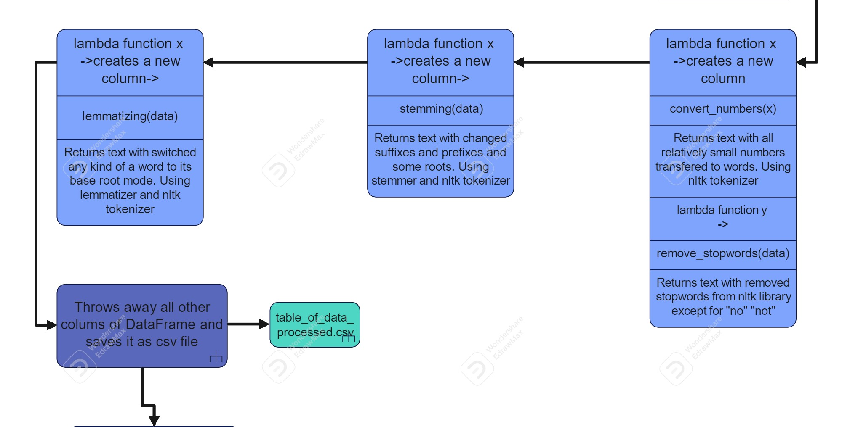
3 . L E M M A T I Z I N G for News and HTML

Slide 15
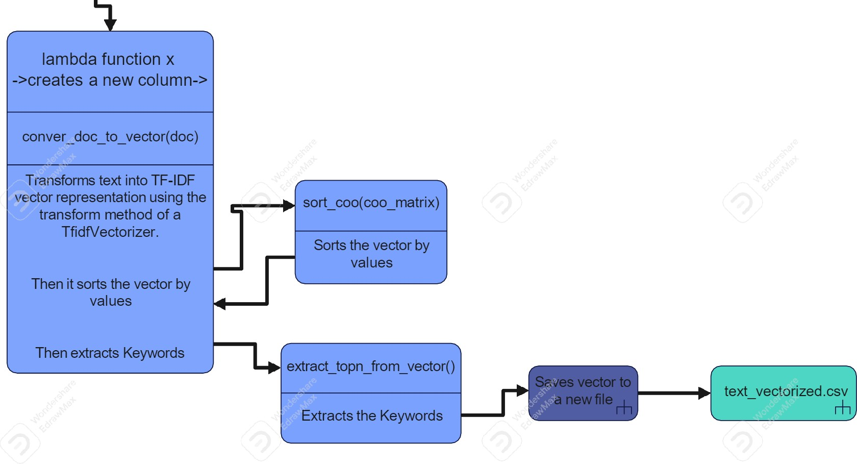
4 . V E C T O R I Z I N G

Slide 16
M E R G I N G D A T A .
Prepare reports a n d n e w s data.
Prepare alarms data.
Prepare weather data.
Merge

Slide 17
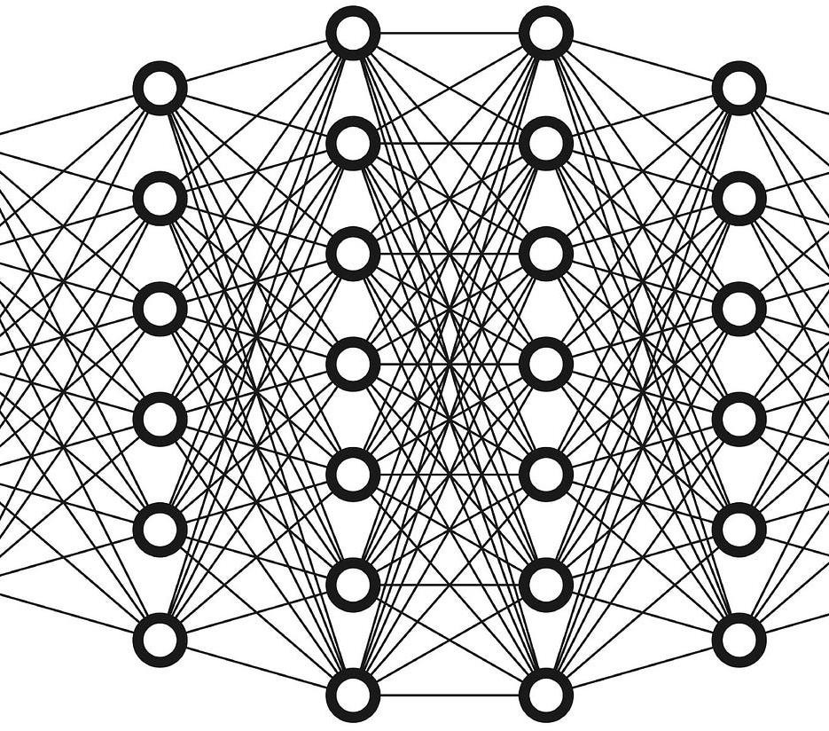
T R A I N I N G
A N D T U N I N G T H E M O D E L .

Slide 18
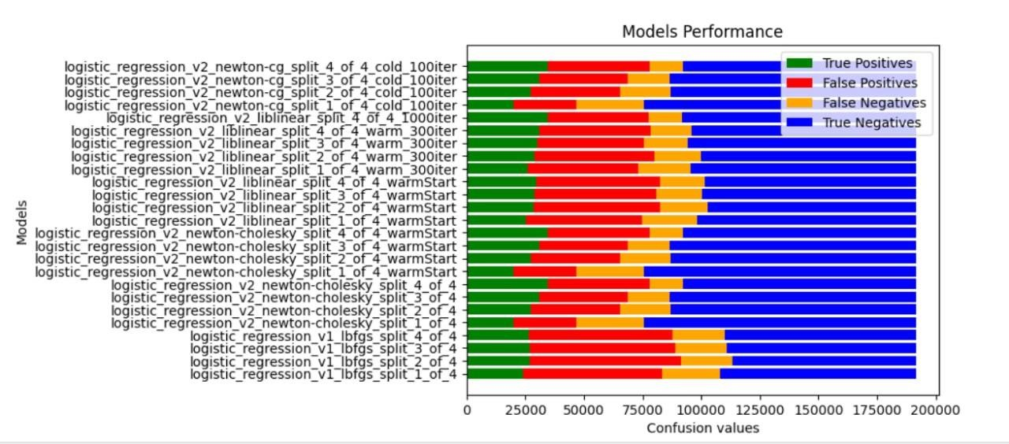
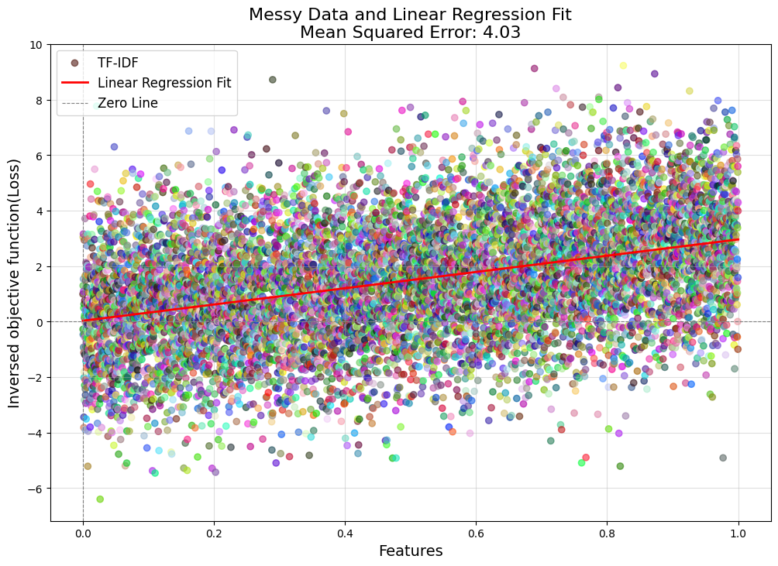

Linear regression performed best among: 1. Linear Regression 2. Random Forest 3. Stochastic Gradient Descent 4. Gaussian Naïve Bayes 5. Regression Decision Tree

Slide 19
T U N I N G
Variable isolation (existing solutions vs self-made).
Reproducibility (random_state).
Number of splits.
Penalty.
Solver
Warm start.
Emphasizing some values in the model

Slide 20
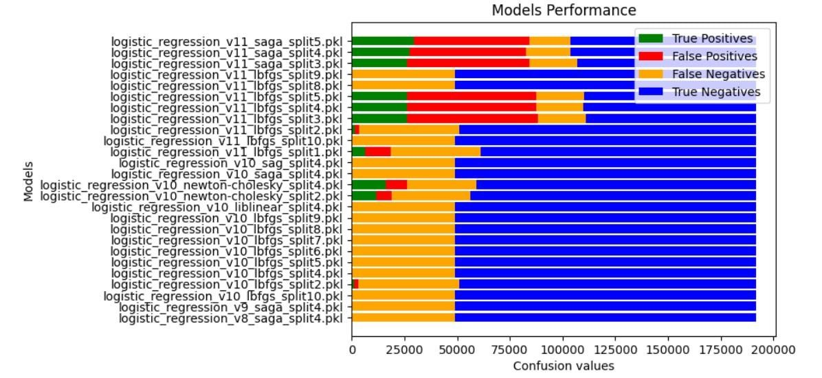

Slide 21
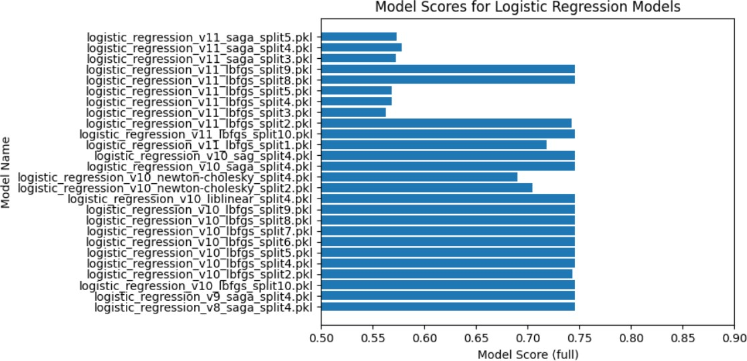
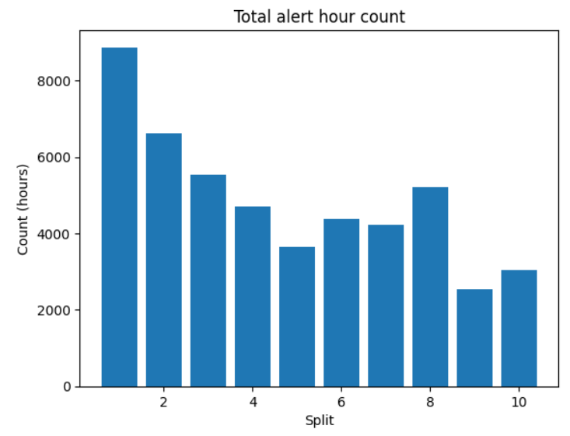
We went on with model: logistic_regression_v11_lbfgs_split9

Slide 22

F R O N T - E N D
/ B A C K - E N D .

Slide 23
S E R V E R .
AWS server
Runs 2 scripts in parallel – frontend and api
Frontend asks API through data link layer
Site is public accessible

Slide 24
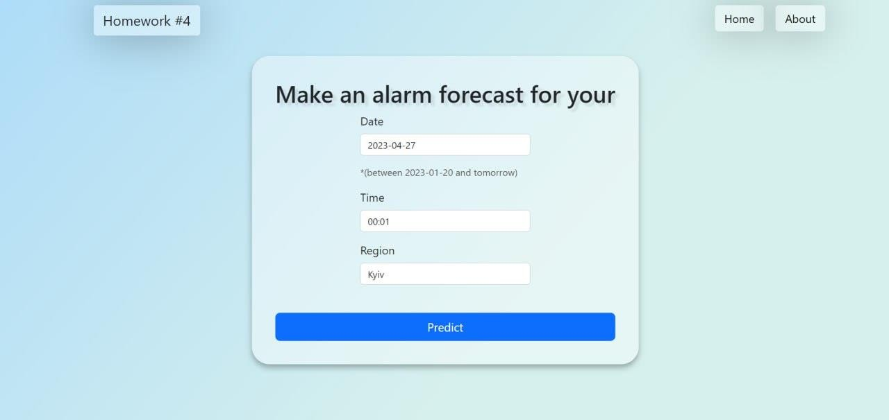


Slide 25
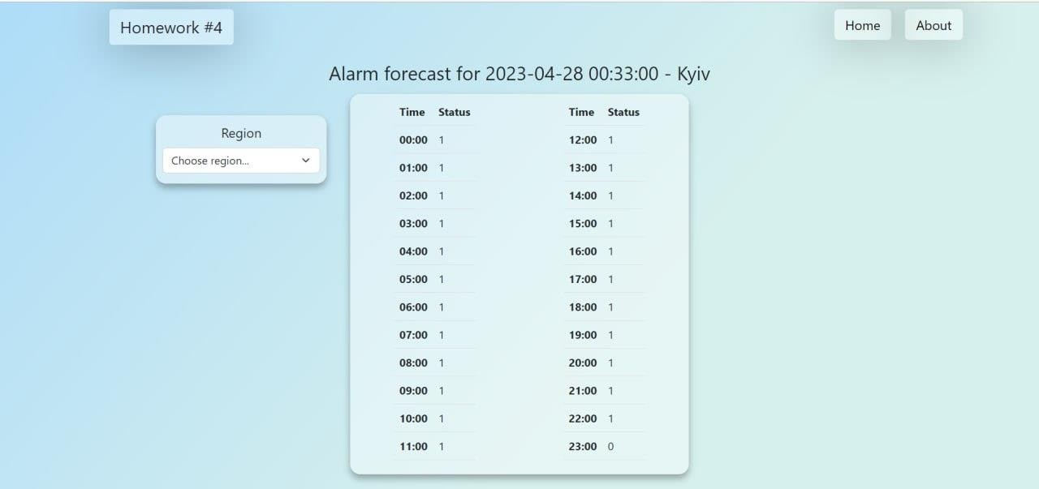

Slide 26
L I N K T O G I T H U B .
H T T P S : / / G I T H U B . C O M / B O H D A N K E N / P R O G A

